Slide 1
Visual outcome of cataract surgery performed by residents Chea Ang^{1*}, Neang Mao^{2*}, Do Seiha^{3*}, Un Leng^{4*}, Ouk Sok Hean^{5*}
Presenter: Dr. Chea Ang

Slide 2
Introduction
Takeo Eye Hospital is one of the training center in Cambodia, providing both clinical and surgial training
Cataract extraction is the most common intraocular surgery taught to residents.
There were more than 2000 cataract surgeries done per year, about 25% of which were performed by senior residents

Slide 3
Introduction
During their third year training, residents are oriented to do cataract surgery (mostly SICS) under supervision of senior ophthalmologists.
So far the training have been going smoothly yet the outcome of their performance was not properly analysed

Slide 4
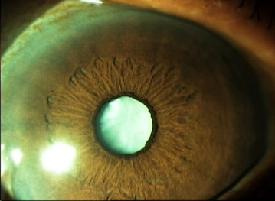
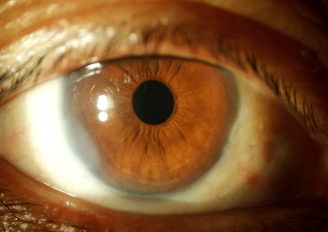
Objective
To analyze the visual outcome in patients undergoing cataract surgery performed by senior residents at TEH during their training program.

Slide 5
Methods
Design: non-comparative retrospective review
100 cataract surgery among 298 eligible patients operated upon by senior residents (third year resident)
Location: Takeo Eye Hospital (TEH) from Jan to October 2014

Slide 6
Methods
Resident surgeons:
Dr. Un Leng
Dr. Tor Remy
Dr. Po Lindara
Dr. Heng Sotheary

Slide 7
Methods
Operation technique: The majority were SICS. However, ECCE-PCIOL) were also done on a few patients as clinically indicated.
Follow up: Follow up was scheduled on day 1, 2 week, and 1 month post-operation.

Slide 8
Result
Age and Sex distribution
There were 64 female (64%) and 36 male (36%) patients
The majority of patients were older than 50 years of age (93.5%) who had age-related cataract
6.5% belongs to the age group of 20-49.

Slide 9
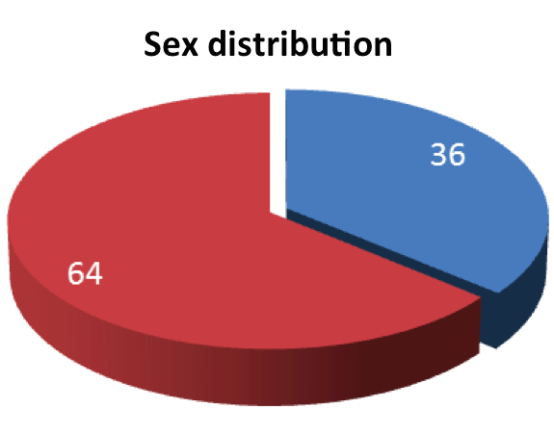
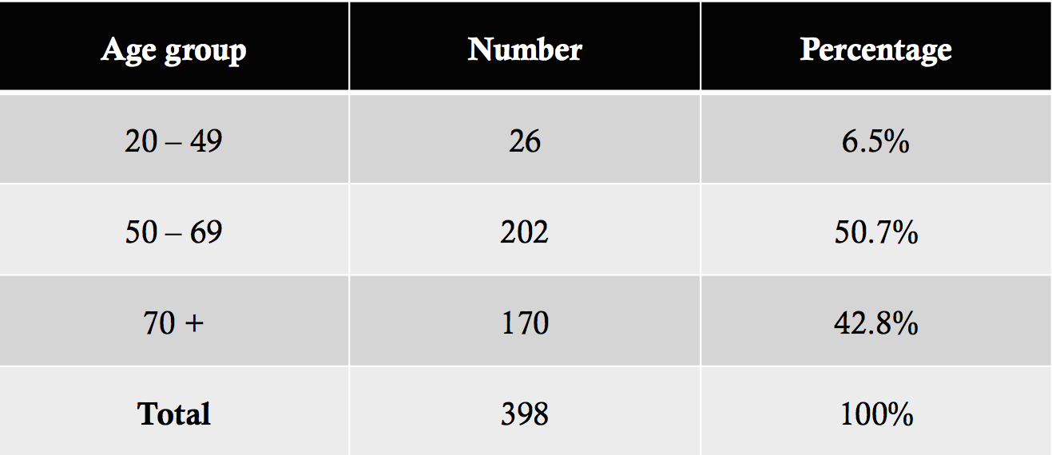
Male
Female

Slide 10
Result
Pre-operatively, presenting visual acuity was poor ( <6/60 ) in 96%
At discharge,
uncorrected visual acuity of > 6/18 was achieved in 46%
44.6% had visual acuity of 6/18 – 6/60
9.4% had poor visual outcome (VA < 6/60)

Slide 11
Resutl
On the 30th postoperative day
VA of > 6/18 was 70.8%
VA of 6/18 – 6/60 was 23.7%
5.5% had poor visual outcome.
Post operative complications
corneal edema 8%
hyphema 5%

Slide 12
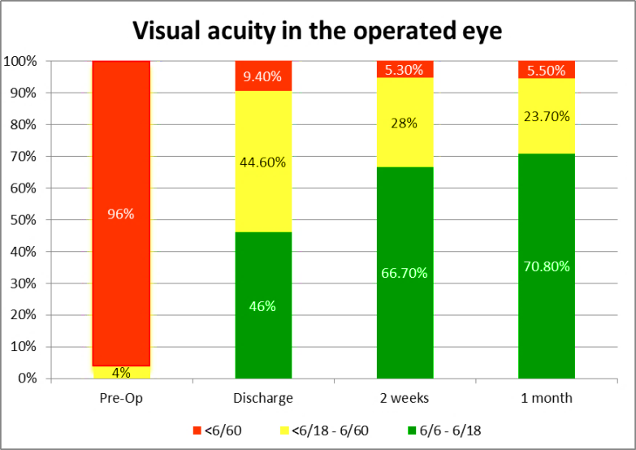

Slide 13
Discussion
A study by R Venkatesh et al. to evaluate the outcome of MSICS and ECCE performed by high volume cataract surgeon showed that 94% had best corrected visual acuity of ≥6/18 compared to 70.8% who had uncorrected visual acuity of > 6/18in the present study.

Slide 14
Discussion
Diverse complications are encountered in SICS carried out by trainees post-operatively. However, in general, these complications in this study are acceptably low. IR Ezegwui et al reported 34% of corneal edema postoperatively following ECCE performed by trainees compared to 8% in this present study.

Slide 15
Conclusion
The quality of cataract surgery by residents during the learning curve has resulted in good visual outcome.
Good case selection and good pre-operation preparation has contributed to the success of good visual outcome.
Additional training is required for better performance of residents, hence SICS should be included in the training program as this cost-effective technique provide acceptable result.

Slide 16
Reference
Resnikoff S et al., Global data on visual impairment in the year 2002. Bull World Health Organ 2004; 82: 844-51
Ezegwui et al., Evaluation of extracapsular cataract extraction performed by trainees. Ann Med Health Sci Res, 2014 Jan; 4(1): 115-7
Moore DB, Slabaugh MA, Surgical outcomes and cost basis for resident-performed cataract surgery in an uninsured patient population. JAMA Ophthalmol, 2013 Jul; 131(7):891-7
Ament et al., Optimizing resident education in cataract surgery, Current Opinion in Ophthalmology, January 2011, p 64–67

Slide 18
Your Commitment Brings Success.

Slide 19
